Slide 1
Dairy-Delights
Enhancing User Experience with Dynamic Product and Order Management

Slide 2
Introduction
This project is a feature-rich e-commerce web application designed for seamless user interaction and efficient management of online shopping tasks.
Key Features:
View Products: Browse product details with an engaging UI.
Cart Management: Add, update, and remove items dynamically.
Order Placement: Collect customer details, validate input, and confirm orders.
Administrator Access: Manage products, view orders, and oversee operations.
Search & Filter: Quickly locate products with advanced filtering options.
Built using React.js, Material-UI, and Axios, this application emphasizes simplicity, responsiveness, and modern design.

Slide 3
Technologies Used :
1.React.js : A JavaScript library for building interactive and dynamic user interfaces.
2.CSS:CSS enhances web design by styling elements, ensuring responsive layouts, and improving user experience
3.Material-UI: A popular React component library for implementing modern, responsive designs.
4. Axios: A lightweight library for making HTTP requests to handle API interactions efficiently.
5. React Router: Provides seamless navigation and routing within the single-page application.
6. JSON Server: A quick backend for simulating RESTful APIs during development.

Slide 4
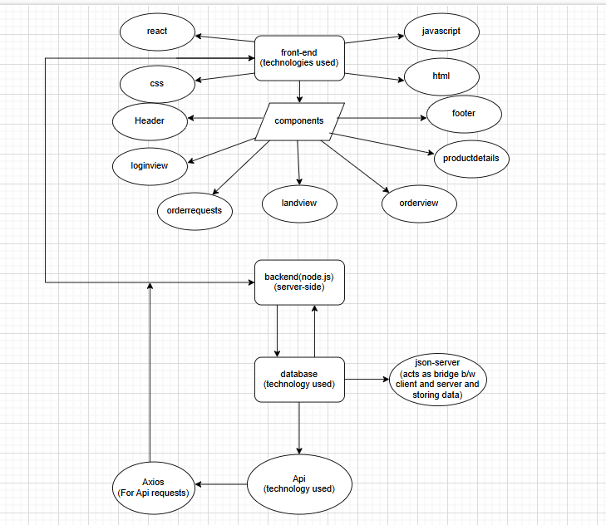
Architecture

Slide 5
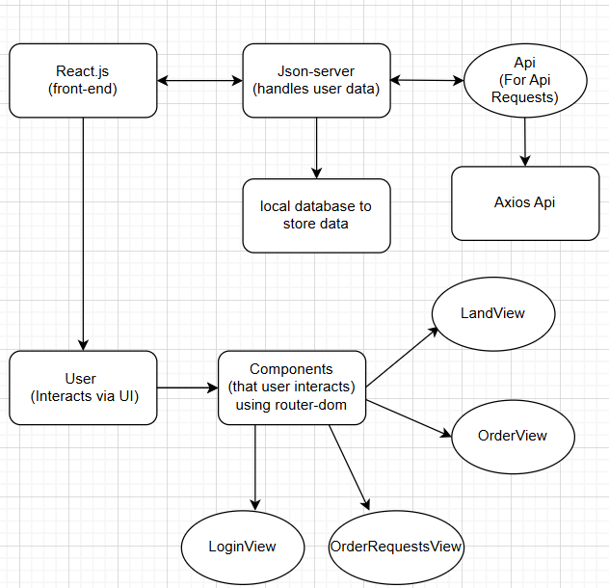
Architecture

Slide 6
Features of SPA:
Fast User Experience: No full-page reloads, only dynamic content updates.
Asynchronous Content Loading: Reduces load times using Axios API.
Efficient Navigation: Client-side routing for seamless navigation.
Reduced Server Load: Only data is exchanged, not entire pages.
State Management: Handles UI state dynamically with JavaScript frameworks.
Single HTML Page: All content is loaded from a single HTML file with dynamically injected sections

Slide 7
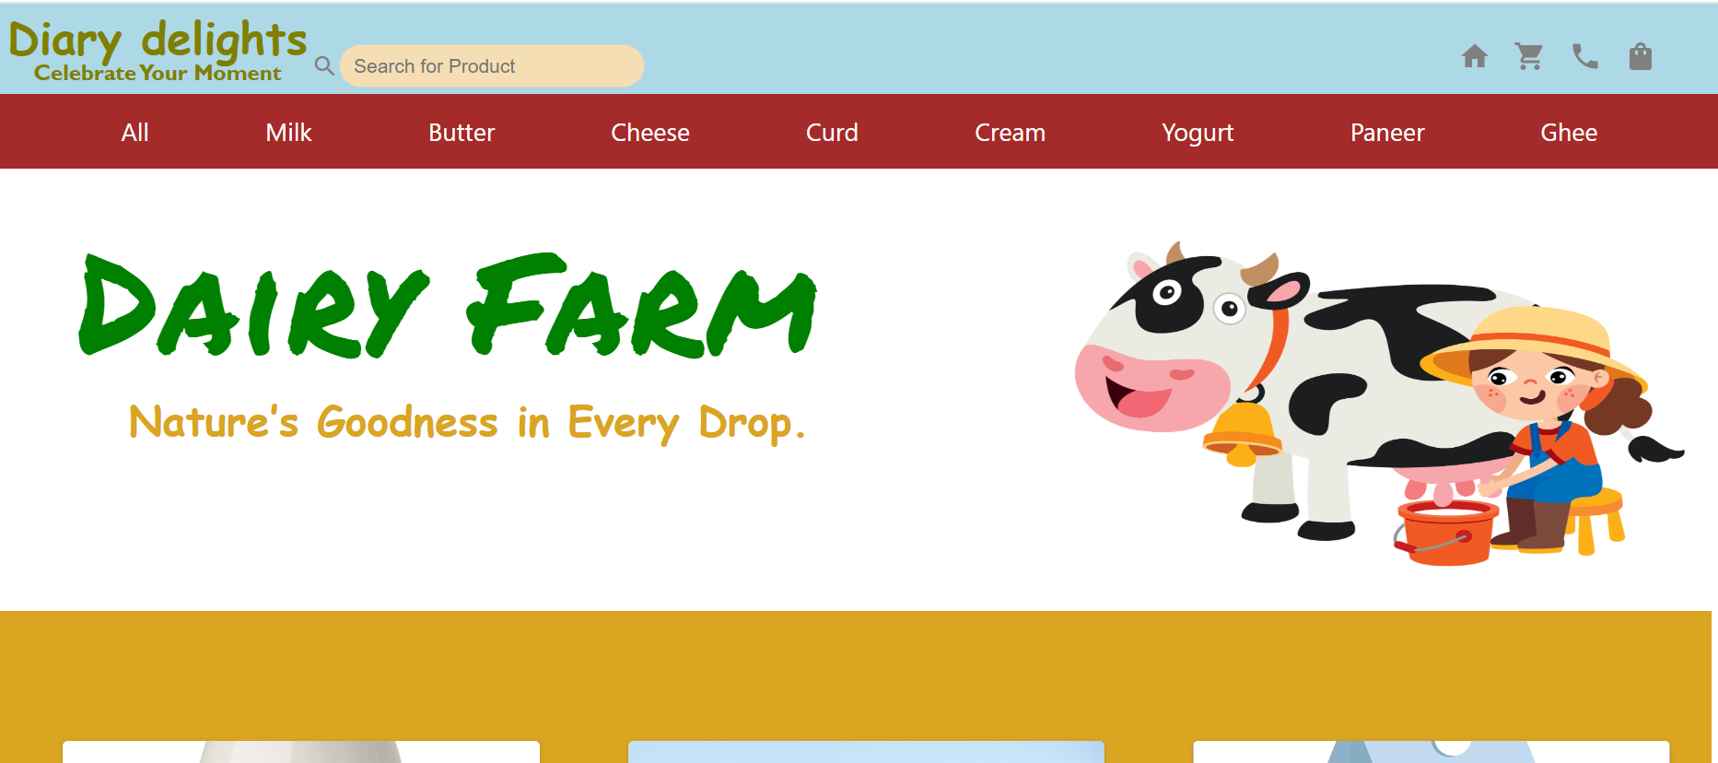
Project Output

Slide 8
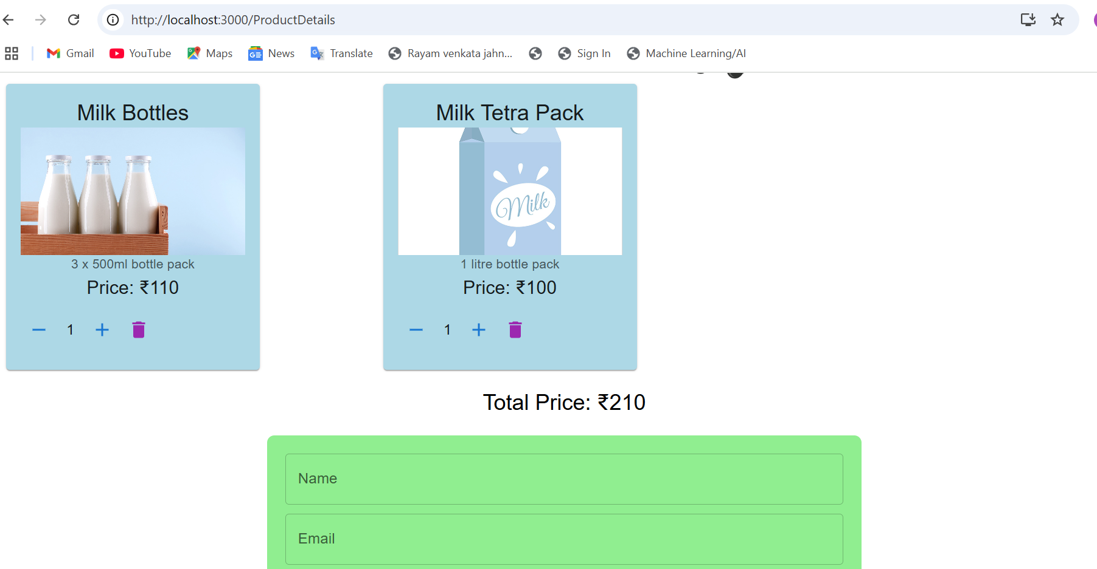

Slide 9
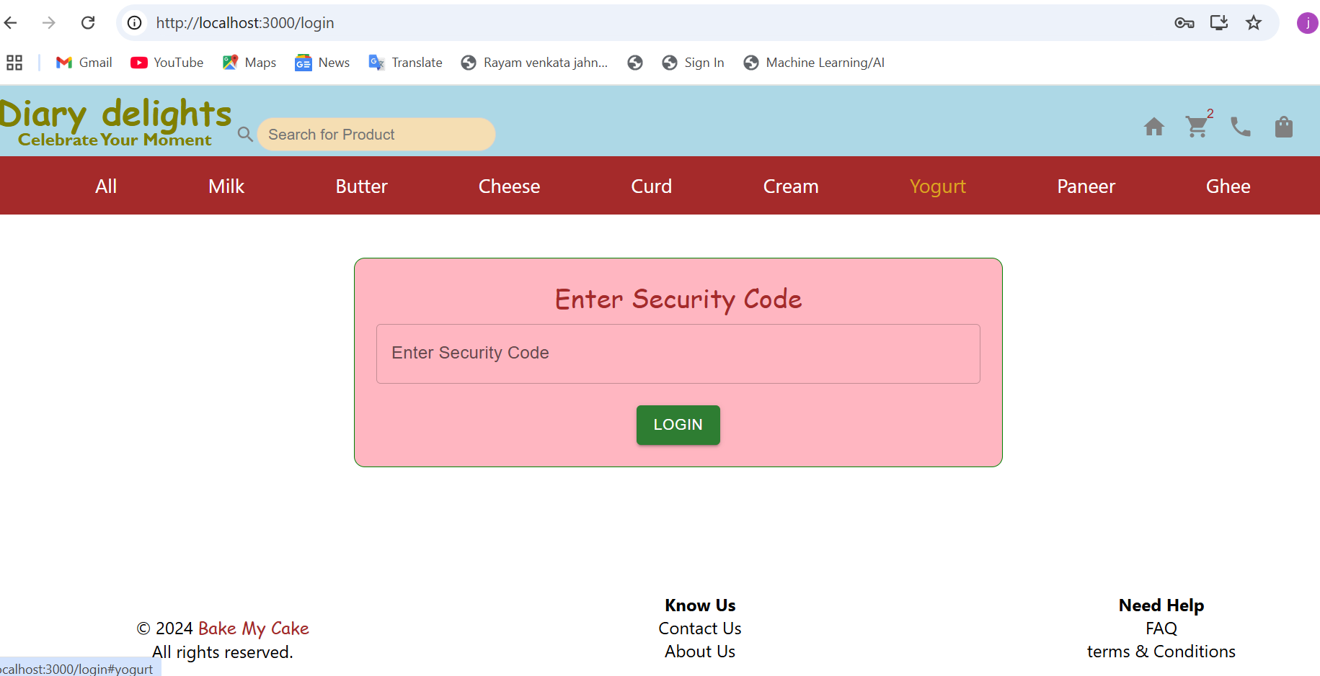

Slide 10
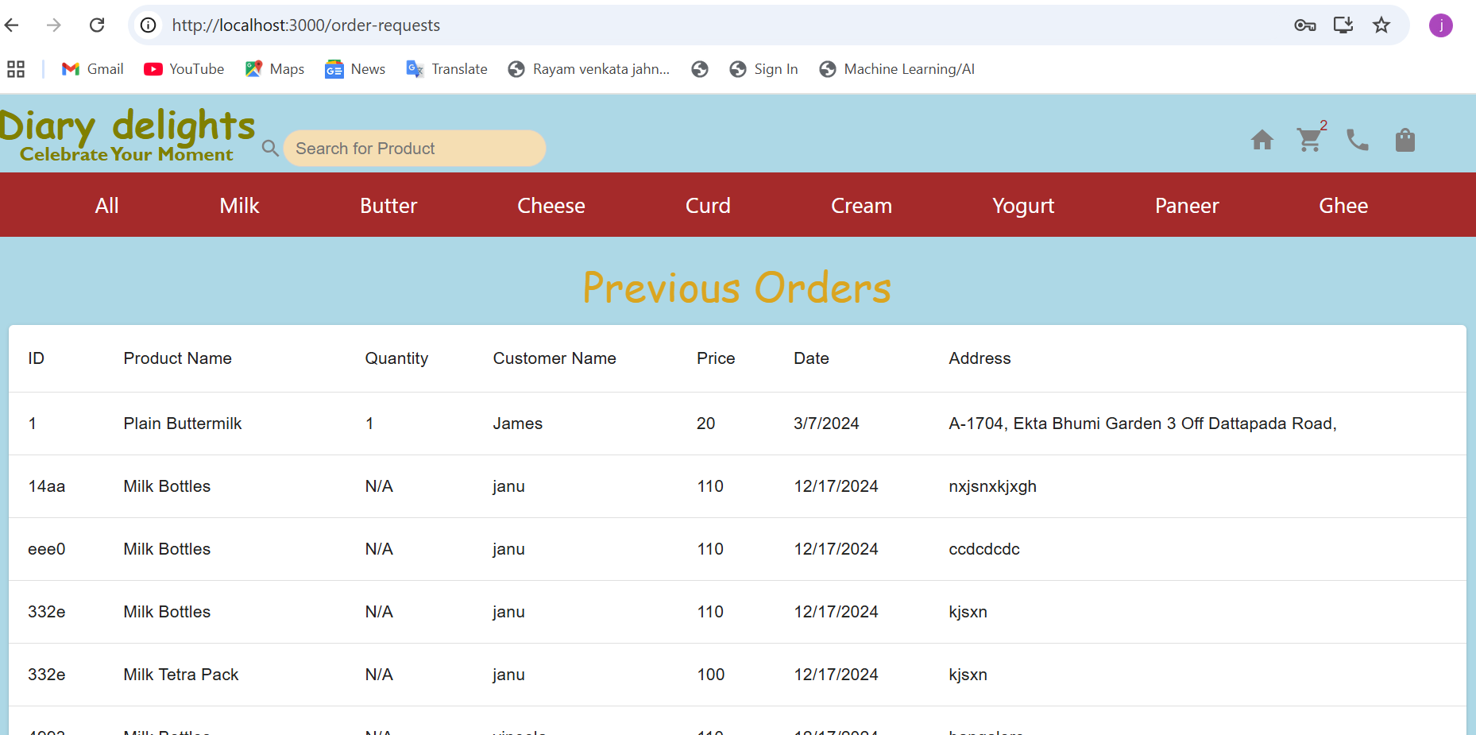

Slide 11


Slide 12


